Slide 1
View interpolation using convolutional neural network : Comparison study
2017.02.23
Hoyeon Lee

Slide 2
Contents
Introduction
Methods
Results
Conclusions
Future works

Slide 3
Introduction
Sparse-view CT is very promising technique for;
Reducing radiation exposure to patients
Less contamination from motion
Reducing operation time

Slide 4
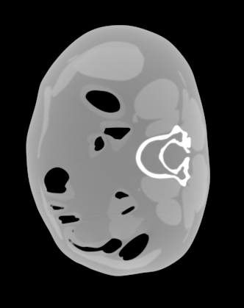
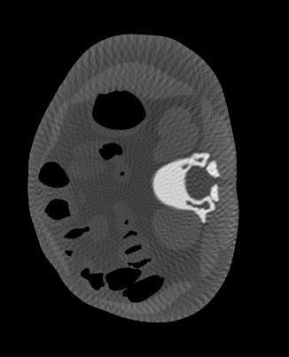
Introduction
Analytic reconstruction of sparse-view CT introduces streak artifacts in result
(a)
(b)
Fig. 1. (a) Reconstructed slice using full-view(680 views), and (b) using sparse-view(170 views)

Slide 5
Introduction
It can be reconstructed with iterative algorithm based on compressed sensing theory
However, those algorithms are computationally expensive
Algorithm dependent artifacts occur in reconstructed images
Stopping the reconstruction is not robust

Slide 6
Introduction
Alternatively, one can make fully-sampled sinogram from sparsely-sampled sinogram using interpolation
Through interpolation, analytic reconstruction algorithm work for reconstruction

Slide 7
Introduction
Convolutional neural network is one of the supervised deep learning method
CNN is usually composed of activation function and three layers;
Convolution layer
Pooling layer
Fully-connected layer
Notes:
Deep learning application

Slide 8
Introduction
CNN is applied various fields in image processing
Segmentation
Localization
Image captioning
Visual questioning

Slide 9
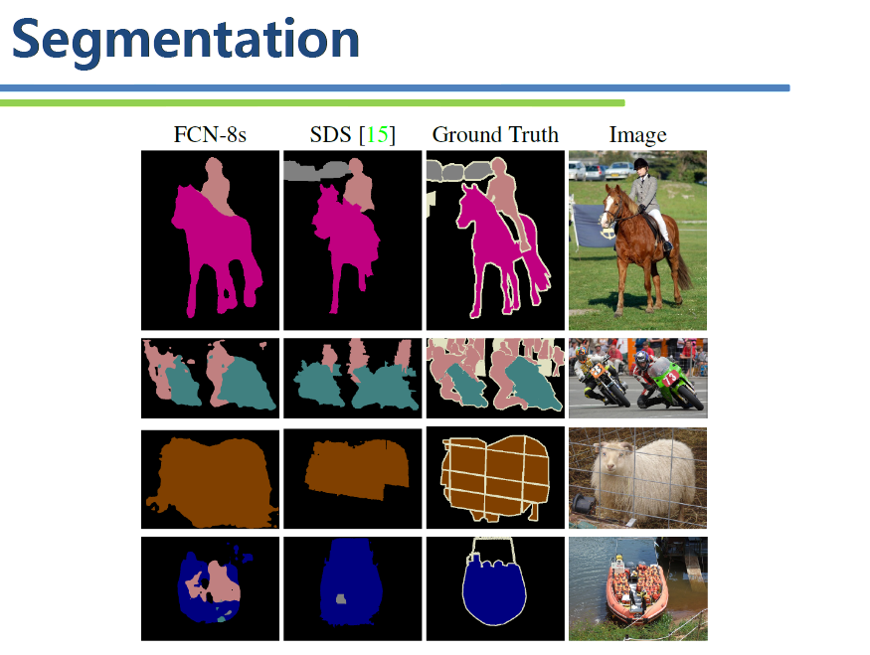
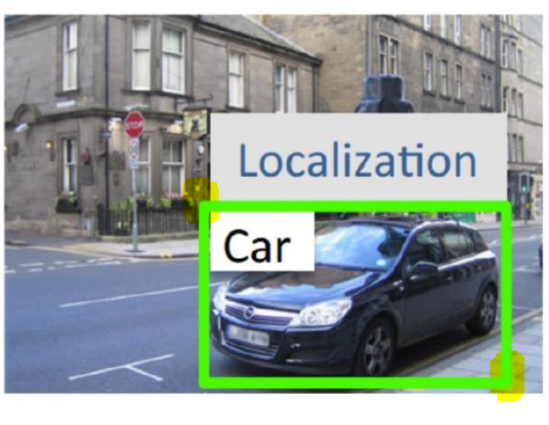
Introduction
Fig. 2. Deep learning application to segmentation
Fig. 3. Deep learning application to localization
Slides from: Spring 2016, EE837, Deep learning for computer vision, Prof. Junmo Kim

Slide 10
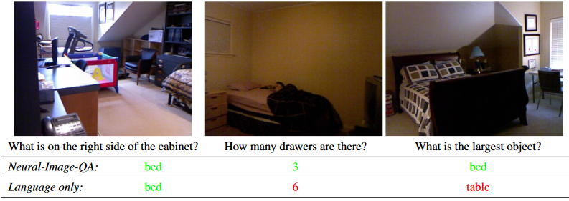
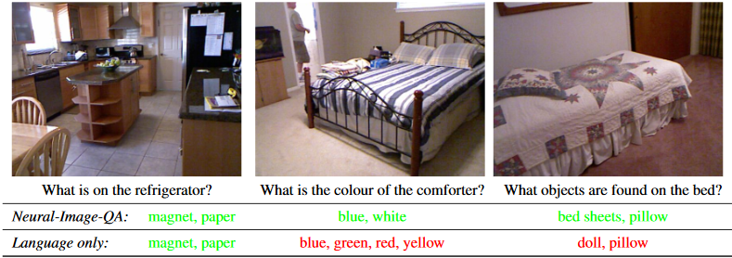
Introduction
Fig. 4. Deep learning application to image based questioning
Mateusz Malinowski, et al., “Ask your neurons: A neural-based approach to answering questions about image”, ICCV (2015)

Slide 11
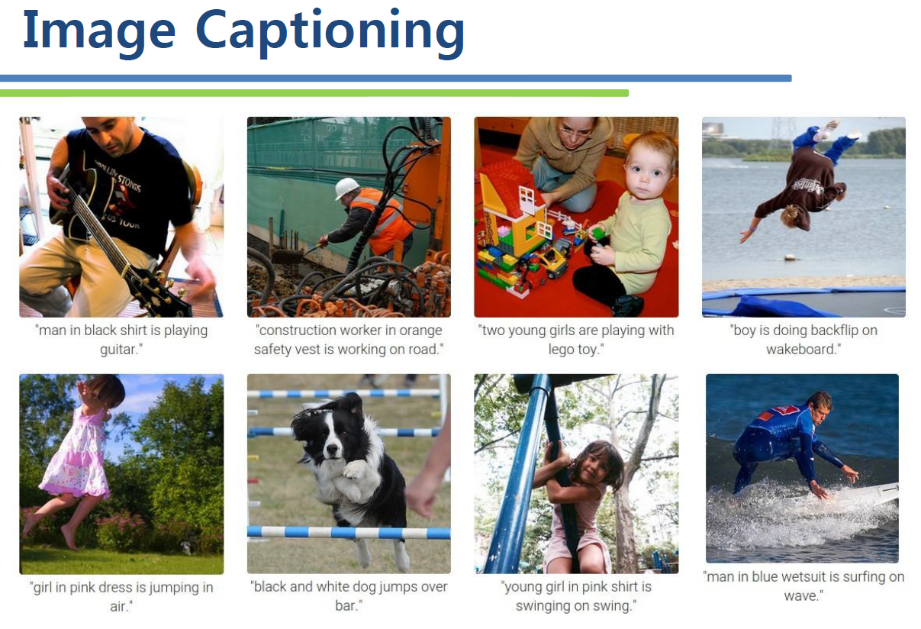
Fig. 5. Deep learning application to image captioning
Slides from: Spring 2016, EE837, Deep learning for computer vision, Prof. Junmo Kim

Slide 12
Purpose
Purpose of this study is to interpolate sparsely-sampled sinogram to fully-sampled sinogram using CNN

Slide 13
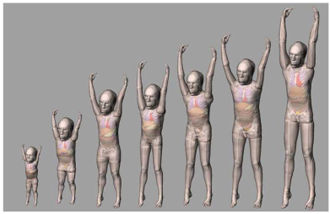
Methods
For simulating CT projection, we obtained projection using XCAT phantom
Fig. 6. XCAT phantoms
W. Paul Segars, et al.,”Mcat to XCAT: The Evolution of 4-D Computerized phantoms for imaging research”, Proc. IEEE, Institute of Electrical and Electronics Engineers, Vol. 97, No. 12 (2009)
Notes:
Projection data / sinogram 680 views

Slide 14
Methods
For sparse-view CT, projection data were quarterly-sampled the original sinogram
Fig. 7. (a) Full-sampled sinogram, and (b) down-sampled sinogram
Notes:
Projection data / sinogram 170 views

Slide 15
Methods
The quarterly-sampled sinogram is up-sampled again
Fig. 8. (a) Full-sampled sinogram, (b) down-sampled sinogram, and (c) up-sampled sinogram from (b)
Notes:
Original/down-sample/up-sample image

Slide 16
Methods
Our network is designed as follows
Fig. 9. Structure of CNN for training

Slide 17
Methods
The sinogram are divided into patches for training
Fig. 10. (a) Up-sampled sinogram, and (b) extracted patches from (a)

Slide 18
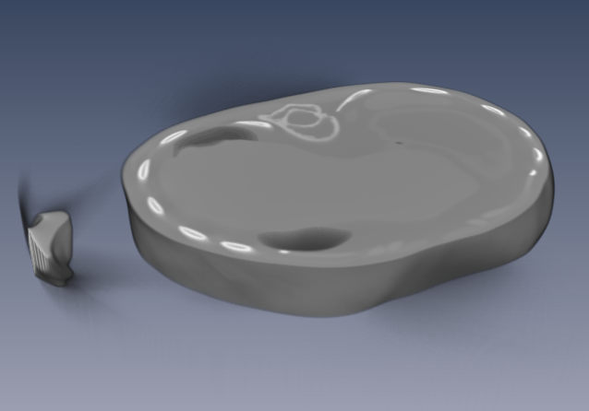
Methods
In previous study, we only used sinogram obtained from abdomen region
Fig. 11. Reconstructed image in abdomen region
Fig. 12. Volume used for training in the previous study

Slide 19
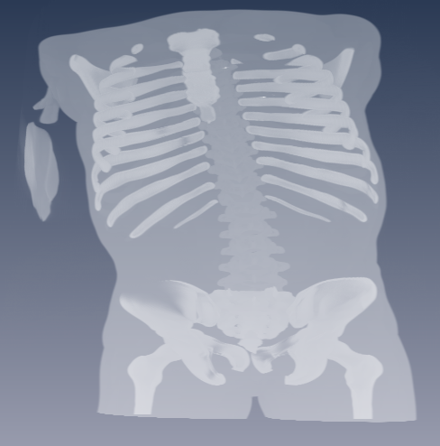
Methods
In this study, we compared results of trained network using different dataset
Abdomen region
Pelvic region
Chest region
Whole body
Fig. 13. Volume used for current study
Notes:
(7*7)

Slide 20
Methods
The networks have same structure, with different learning rate
Learning rates did not change while training
Momentum was 0.1 and weight decay was 0.0001 for all trainings
Table. Ⅰ. Learning rates for each training dataset
Dataset | Learning rate
Chest region | 0.0001
Pelvic region | 0.0001
Abdomen region | 0.0005
Whole body | 0.0001

Slide 21
Methods
After training was done, we tested model with following network
Fig. 14. Structure of network for testing

Slide 22
Results
Four different trained network were tested with three sinogram from different region of body
The results from CNN are compared to interpolation methods(linear, directional)
Interpolated sinogram were reconstructed using filtered back-projection(FBP) algorithm

Slide 23
Results
Training errors
Fig. 15. Training error using whole body sinogram
Fig. 16. Training error using chest sinogram

Slide 24
Results
Training errors
Fig. 17. Training error using pelvic sinogram
Fig. 18. Training error using abdomen sinogram

Slide 25
Results
Fig. 19. (a) Ground truth sinogram, (b) linear interpolated sinogram, (c) directional interpolated sinogram, (d) deep interpolated sinogram using chest dataset, and (e) deep interpolated sinogram using whole body dataset
Notes:
0002

Slide 26
Results
Fig. 20. Expansion of red-boxed regions in (a) Ground truth sinogram, (b) linear interpolated sinogram, (c) directional interpolated sinogram, (d) deep interpolated sinogram using chest dataset, and (e) deep interpolated sinogram using whole body dataset

Slide 27
Results
Fig. 21. Reconstructed image of (a) Ground truth sinogram, (b) linear interpolated sinogram, (c) directional interpolated sinogram, (d) deep interpolated sinogram using chest region dataset, and (e) deep interpolated sinogram using whole body dataset

Slide 28
Results
Fig. 22. Line profiles of red-line in Fig. 21

Slide 29
Results
Table Ⅱ. Quantitative comparison results of pelvic region sinogram
 | RMSE | PSNR
Whole body dataset | 0.008940 | 40.972776
Chest region dataset | 0.010569 | 39.519523
Linear | 0.019772 | 34.079055
Directional | 0.036504 | 28.753100
Table Ⅲ. Quantitative comparison results of pelvic region reconstructed images
 | RMSE | PSNR
Whole body dataset | 0.000176 | 75.075560
Chest region dataset | 0.000200 | 73.969920
Linear | 0.000506 | 65.918773
Directional | 0.000896 | 60.958678

Slide 30
Results
Fig. 23. (a) Ground truth sinogram, (b) linear interpolated sinogram, (c) directional interpolated sinogram, (d) deep interpolated sinogram using abdomen dataset, and (e) deep interpolated sinogram using whole body dataset

Slide 31
Results
Fig. 24. Expansion of red-boxed regions in (a) Ground truth sinogram, (b) linear interpolated sinogram, (c) directional interpolated sinogram, (d) deep interpolated sinogram using abdomen dataset, and (e) deep interpolated sinogram using whole body dataset

Slide 32
Results
Fig. 25. Reconstructed image of (a) Ground truth sinogram, (b) linear interpolated sinogram, (c) directional interpolated sinogram, (d) deep interpolated sinogram using abdomen region dataset, and (e) deep interpolated sinogram using whole body dataset

Slide 33
Results
Fig. 26. Line profiles of red-line in Fig. 27

Slide 34
Results
Table Ⅳ . Quantitative comparison results of abdomen region sinogram
 | RMSE | PSNR
Whole body dataset | 0.007089 | 42.988355
Abdomen region dataset | 0.007155 | 42.908087
Linear | 0.013066 | 37.677442
Directional | 0.028871 | 30.790824
Table Ⅴ. Quantitative comparison results of abdomen region reconstructed images
 | RMSE | PSNR
Whole body dataset | 0.000152 | 76.357711
Abdomen region dataset | 0.000156 | 76.126944
Linear | 0.000316 | 70.004679
Directional | 0.000675 | 63.407814

Slide 35
Results
Fig. 28. (a) Ground truth sinogram, (b) linear interpolated sinogram, (c) directional interpolated sinogram, (d) deep interpolated sinogram using pelvic dataset, and (e) deep interpolated sinogram using whole body dataset

Slide 36
Fig. 29. Expansion of red-boxed regions in (a) Ground truth sinogram, (b) linear interpolated sinogram, (c) directional interpolated sinogram, (d) deep interpolated sinogram using pelvic dataset, and (e) deep interpolated sinogram using whole body dataset

Slide 37
Results
Fig. 30. Reconstructed image of (a) Ground truth sinogram, (b) linear interpolated sinogram, (c) directional interpolated sinogram, (d) deep interpolated sinogram using pelvic region dataset, and (e) deep interpolated sinogram using whole body dataset

Slide 38
Fig. 31. Line profiles of red-line in Fig. 32

Slide 39
Results
Table Ⅵ. Quantitative comparison results of chest region sinogram
 | RMSE | PSNR
Whole body dataset | 0.005156 | 45.753042
Pelvis region dataset | 0.005862 | 44.639281
Linear | 0.013027 | 37.703008
Directional | 0.045775 | 26.787440
Table Ⅶ. Quantitative comparison results of chest region reconstructed images
 | RMSE | PSNR
Whole body dataset | 0.000085 | 81.455950
Pelvis region dataset | 0.000089 | 81.022142
Linear | 0.000316 | 69.999709
Directional | 0.000869 | 61.221183

Slide 40
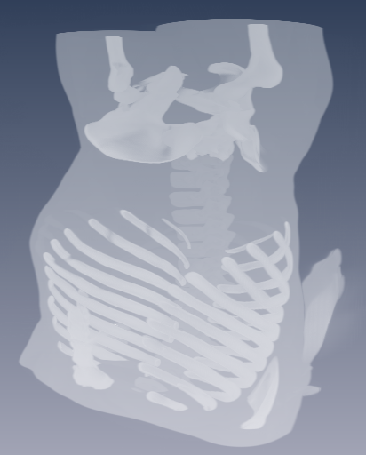
One big mistake!

Slide 41
Conclusions & Discussions
CNN works well for interpolating sparsely-sampled sinogram
It outperforms than the other interpolation method
Review of directional interpolation required

Slide 42
Future works
Train the network with new dataset
Use 3D convolution to perform interpolation in cone-beam CT
Compare the method to iterative reconstruction results
Add noise to the projection data to train the network robust to noise

Slide 43
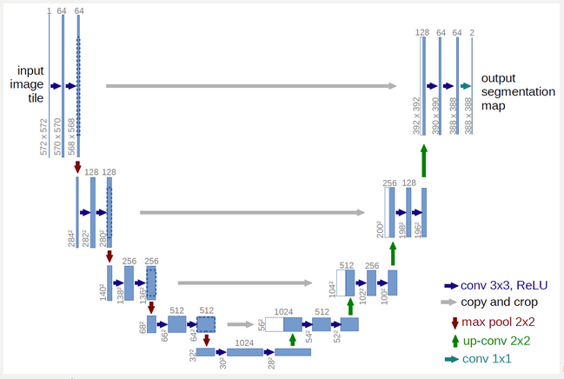
Future works
Apply deconvolution to train the network without interpolating the sinogram
Olaf Ronneberger, et al., “U-Net: Convolutional networks for biomedical image segmentation”, MICCAI, Vol. 9351, 234-241(2015)

Slide 44
Thank you for listening

Slide 45
Methods
Convolutional layer
Pooling layer
Fully-connected layer
Activation function

Slide 46
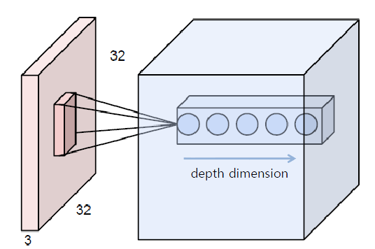
Methods
Convolution layer

Slide 47
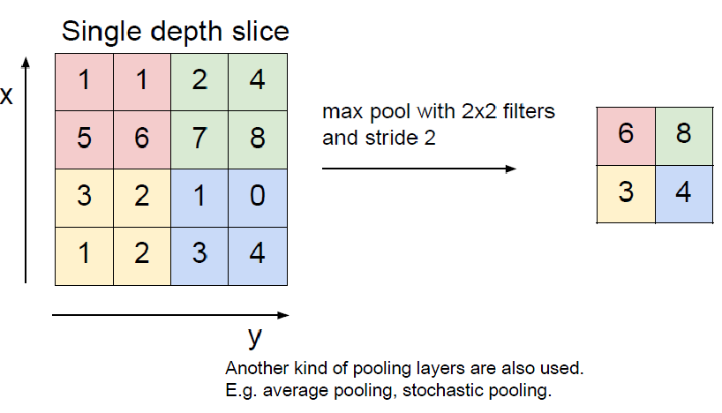
Methods
Pooling layer

Slide 48
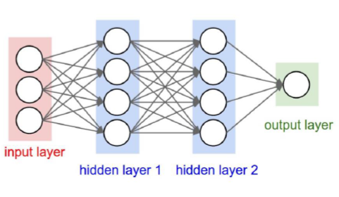
Methods
Fully-connected layer

Slide 49
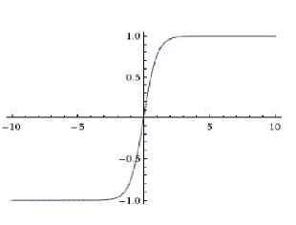
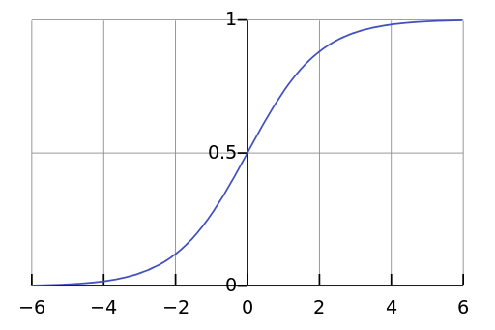
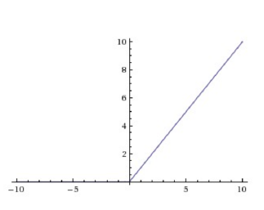
Methods
Activation functions
Introduce non-linearity in networks
tanh
sigmoid
ReLU
By Qef (Created from scratch with gnuplot) [Public domain], via Wikimedia Commons

